Slide 1

2015 World Finals
Jurijs Jefimovs

Slide 2
Problem definition & Solution
Bug similarity and sentiment analysis
+ Dimensional modelling
+ Visualization
How this can be used?
Data exploratory analysis
Bug monitoring
Bug similarity analysis
Notes:
I’ve build a analytical tool which helps to
analyse and explore similar bugs (clusters)
Slice and dice clusters against different dimensions
Monitor bugs over time
+ sentiment score for bugs

Slide 3
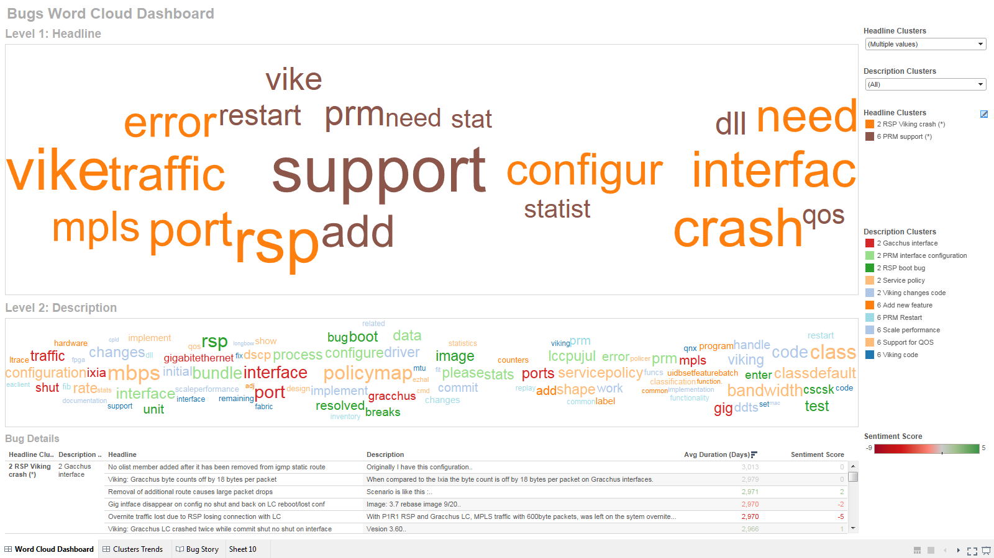
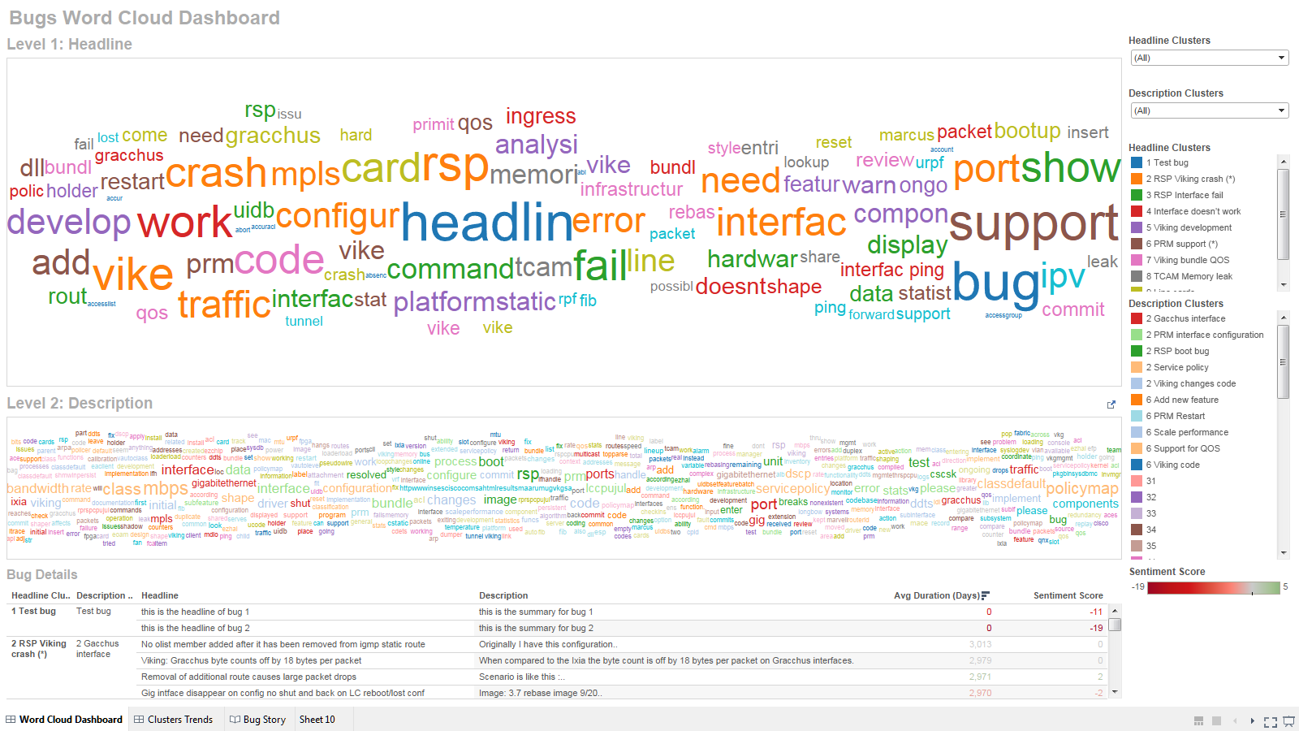

Slide 4
